Slide 1


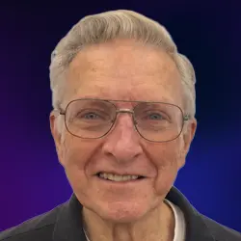
Ron Turner
Founder & CEO
Audithentic.ai
Churn Measurement in a Data Science Stack for Detecting Nefarious Activity
Notes:
Hello everyone,
I’m Ron Turner. Audithentic.ai is the name of my company and is the link to its web site. We are in the business of mitigating internal fraud in small organizations, non-profits in particular.
Today’s session is about how we’ve exploited various layers of the Data Science stack and about an innovative statistical measure which we’ve named “Churn.” And to clarify, this not the “churn” in customer resource management (CRM) systems. Instead our “churn” is a measure of human day-to-day activity in an organization’s ledger.
Thanks for joining us in a trip that we hope will help you solve some tough-nut problems in your workplaces.

Slide 2
Road Map: Outcomes and Takeaways
Scenario and current gaps
Open-source Next-Gen Accounting Monitoring Engine (NGAME™) overview
Architecture and Processes
Web Ontology Language (OWL) activity
Churn statistics for anomaly detection
Human-Computer Interface (HCI)
Training Matrix
Invitation: GitHub (cloned app, install and implementation guides, related artifacts)
Notes:
The technology we’re covering this morning did not come from nowhere. We were motivated by repeated by some painful scenarios and technology gaps. There is a lot to cover, so we will move quickly to give you an accurate and honest view of its fit in a small organization. The Agent architecture and process flow will expose the elements of the data science stack. We’ll explain why OWL is a key player. NGAME’s Training Matrix is the faithful EKG of the organization’s bookkeeping activity. Churn is the novel measure that generates credible warnings as humanly readable “pictures.” Most importantly, we’ll invite you clone all of the 21K+ lines of code and ample documentation.
1:07

Slide 3
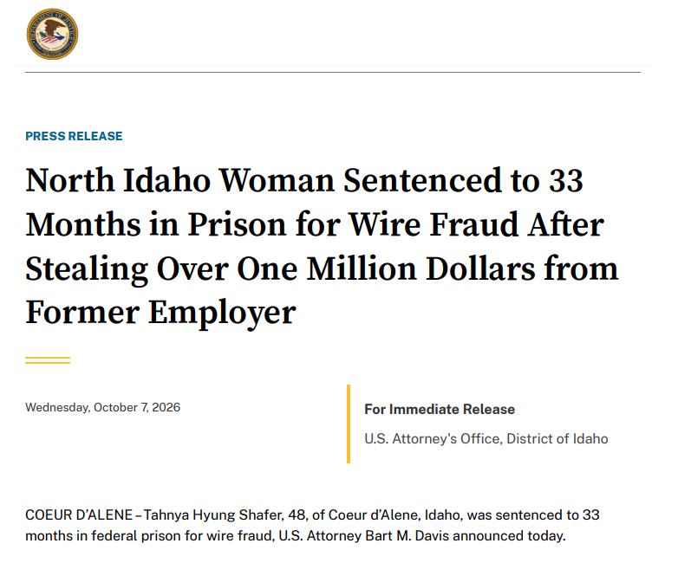
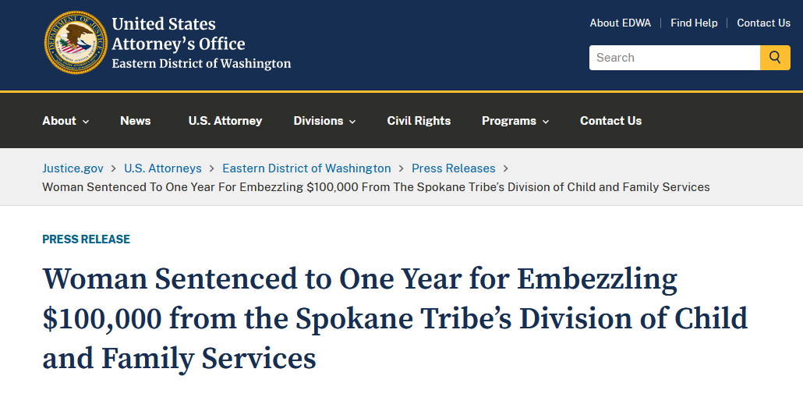
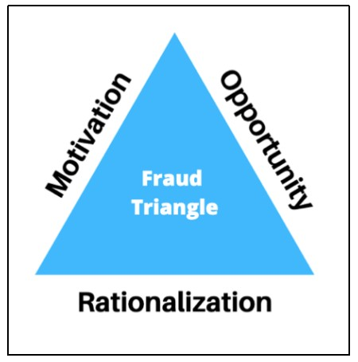
Why does this keep happening?
+ Trust
‘Wiped us out completely’: Trusted small-town clerk emptied Metaline’s bank account, cratered nonprofit
Notes:
How in the blazes did we ever get into this mess? How could Louise, of all people—hardworking bookkeeper and dear sister-in-law of the owner—wind up in federal custody?!
These are recent cases prosecuted just within miles of us. And it’s same everywhere and in all kinds of small organizations: charities, churches, PTA’s, Meals on Wheels, animal shelters, warming shelters….. How can this keep happening?
Well, actually for at least three simple reasons:
The famous Fraud Triangle tells us that Louise—motivated by impending payments (“I’m gonna lose my house!) and with the most sincere rationalization (“I’ll pay it back…. Somehow”)—CAN embezzle. So she DOES.
But more importantly, the Chain of Trust is often week or broken.
But why didn’t Larry, the financially responsible person (FRP) keep his eye on the books. After all, he’s got QuickBooks’ Audit Log.
1:14

Slide 4
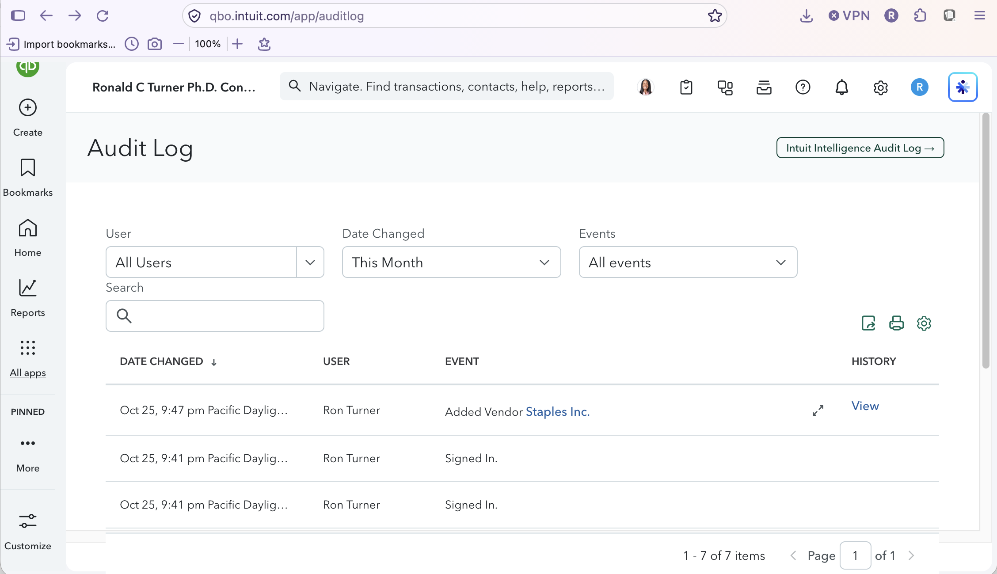
QBO Audit Log
Notes:
As a small business owner who’s been embezzled, don’t tell me that I SHOULD have gone to QuickBooks more regularly to see exactly who did what! And besides, when I look at “who did what?” in the Audit Log. It doesn’t give me the slightest hint of anything’s being fishy.
And I need more than Best Practices in ring binders. And we certainly can’t afford to bring in an internal auditor simply as a watchdog. I absolutely need to run to the Audit Log, but only when I know there’s a fire to put out. I HAVE to know then who did what, what they did, when they did it, every time they did it. The Audit Log is great. But give me a watchdog that keeps its eye on things CONTINUOUSLY and then warns me ON ITS OWN.
:50

Slide 5
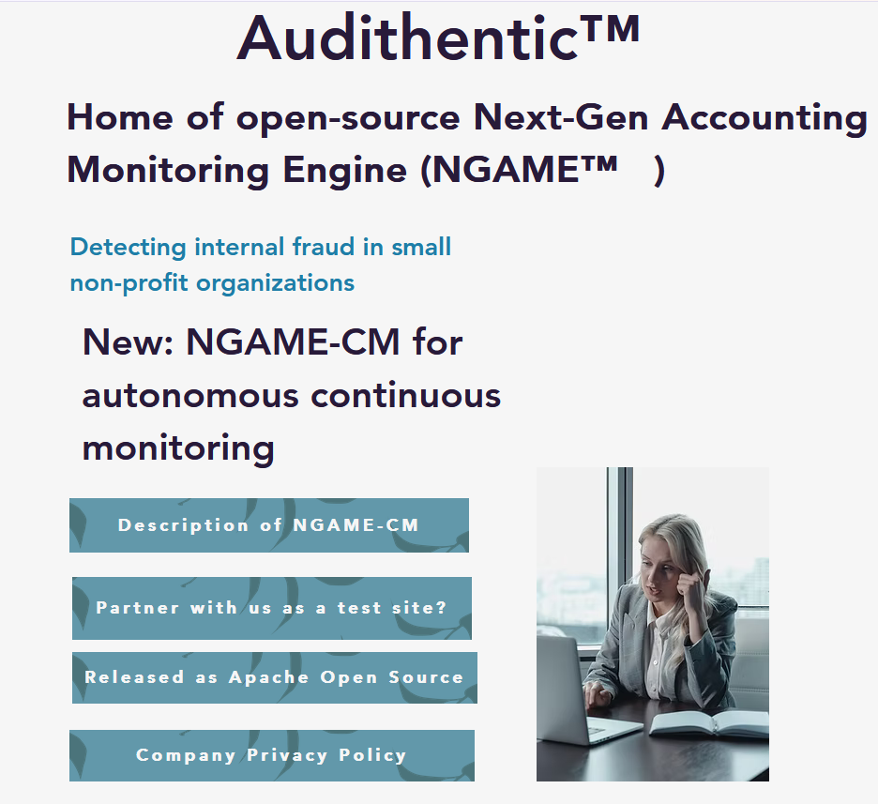
Respectfully enhancing the Chain of Trust in small organizations:
“NGAME-CM is strictly a surveillance engine that monitors transactions, detecting suspicious transaction activity and issuing warnings along with their levels of severity. It does not see every save nor does it identify the user. It does not read the QuickBooks Audit Log but prompts the FRP with actionable information so as prevent “warning fatigue.”
-- From “Description of NGAME-CM” in Audithentic.ai web page
Notes:
Everything we’re looking at today is about open-source NGAME-CM for continuous monitoring. Audithentic.ai is our registered company name and the full link to our web page. As you can see from the language, our approach is modest and discreet.
It makes no claims about replacing a live internal auditor or providing a full internal audit or offering trial-level admissible evidence.
It does not access system audit logs to determine a user’s identity.
It only provides warnings that are fact-based and actionable to the financially responsible person (FRP). They must decide whether some suspicious activity is nefarious, whether an embezzlement is actually in progress.
:59

Slide 6
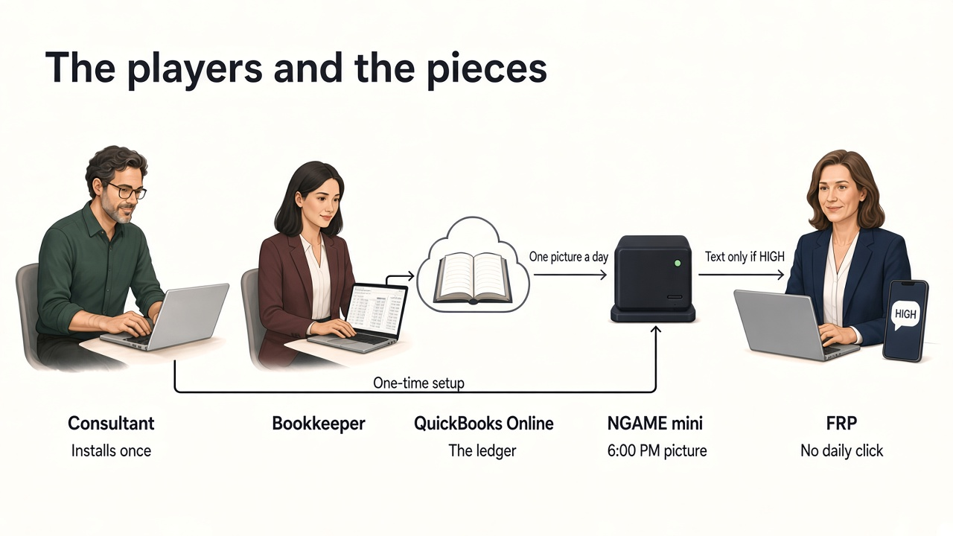
Notes:
This is the Big Picture Slide, so we’re going to stay for about 3:40 minutes.
There’s a hidden confession in this nice happy-face picture. The hint is the little red box with “No daily click.” When we first deployed open-source NGAME, we thought that the FRP would find it entertaining simply to click a button on her office machine’s NGAME dashboard and see things happen on her screen. Her actual response was more like “Are you kidding?! I work often at home with four kids to manage and I can’t come in to push buttons on that NGAME computer—those daily clicks for training NGAME and occasional buttons to click for ‘fishy’ activity.” So that triggered a major redevelopment project, which was to turn NGAME (with its “entertaining dashboard”) to a fully autonomous, continuous monitoring engine. THAT’s the product. And THAT’s the GitHub repo you’ll need to clone. Here are seven bit-picture items to consider (When you go to the GitHub repo, you can download this PPT file, including the notes I’m following):
A continuous monitoring system requires a dedicated computer: always-on, running NGAME continuously, amd with sufficient memory to host a local LLM.
The preferred machine is a Geek-um mini PC with 16MB of memory and 1TB of storage. (I’m presenting right now with this amazing little 4 ½” x 4 ½” box.
Because the LLM is local and because the mini PC operates with only 40 watts, NGAME incurs only a tiny “AI carbon debt.”
Installation requires a system-savvy person—that’s the “Consultant” in the picture--who can navigate folders and do” PowerShell commands.
The Installation Guide is a very detailed 32-page document, designed in cookbook-style: “do this, see that, next do this, if you don’t this, do that..” I’d almost bet that it is among the most thorough and carefully tested manuals on GitHub!
The bookkeeper sees nothing. NGAME is not on her computer and does not access her computer. And she may not even be aware of NGAME at all.
The total office activity is (1) the FRP’s iPhone tells her that something’s fishy in the books. (2) That prompts the FRP to look at the day’s NGAME “picture” and then (3) access the QuickBooks Audit Log.
I know I promised a “live demo” with its entertaining buttons and dashboard when I submitted for this conference months ago. but that was before NGAME-CM, so now a demo would be like watching paint dry. But we will look at warning screens here a little later.

Slide 7
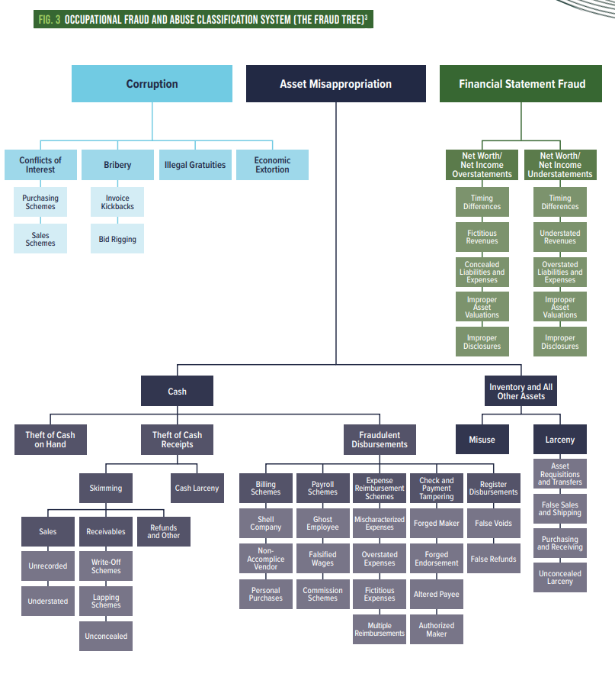
Asset Misappropriation
Frequency: Most common (accounts for roughly 86%–89% of all occupational fraud cases). [1, 2, 3]
Definition: When an employee steals, misuses, or dissipates company resources. [1]
Key Subcategories:
  Cash Schemes: Skimming, cash larceny, and fraudulent disbursements (billing schemes, payroll schemes, expense reimbursement schemes, check tampering).
  Non-Cash Schemes: Misuse or theft of inventory, equipment, and other company assets. [1]
Notes:
This is the focus of NGAME, the “Fraud Tree” published by the Association of Certified Fraud Examiners. The sub-class we’re interested in is “Misappropriation of Assets,” the type of fraud in all three of the cases we saw earlier. And we’re primarily focused on the “Cash” sub-category.
Our approach to manipulating the AFCE Fraud Tree was to render (once-and-for-all) the Misappropriation sub-tree (or “taxonomy,” as we call it) as an OWL ontology. In doing so, we’re not just trying to look smart or cute. Instead we found that OWL—as a World Wide Web Consortium (W3C) standard—further enforces a standards-based architecture for NGAME. But we get a lot more.
:60

Slide 8
OWL for Lossless Semantics
Install Stanford’s Protégé to view NGAME’s OWL renditions:
  ACFE’s Fraud Taxonomy
  Intuit’s out-of-the-box Chart of Accounts
  Data behind NGAME’ s day-to-day Churn Picture :
https://protege.stanford.edu/software/
Notes:
When NGAME reads all the detail of all the day’s transactions, it must retain all of that detail in as compact a form as possible as the agents pass around the transactions. (This is like the lowly “intermediate representations” in earlier software architectures.) Thanks to OWL renditions of NGAME’s key data files, none of that detail is lost. So, thanks to OWL, it is fair to claim a standards-based and consistent “Lossless Semantics” in transfers across all of those files.

Slide 9
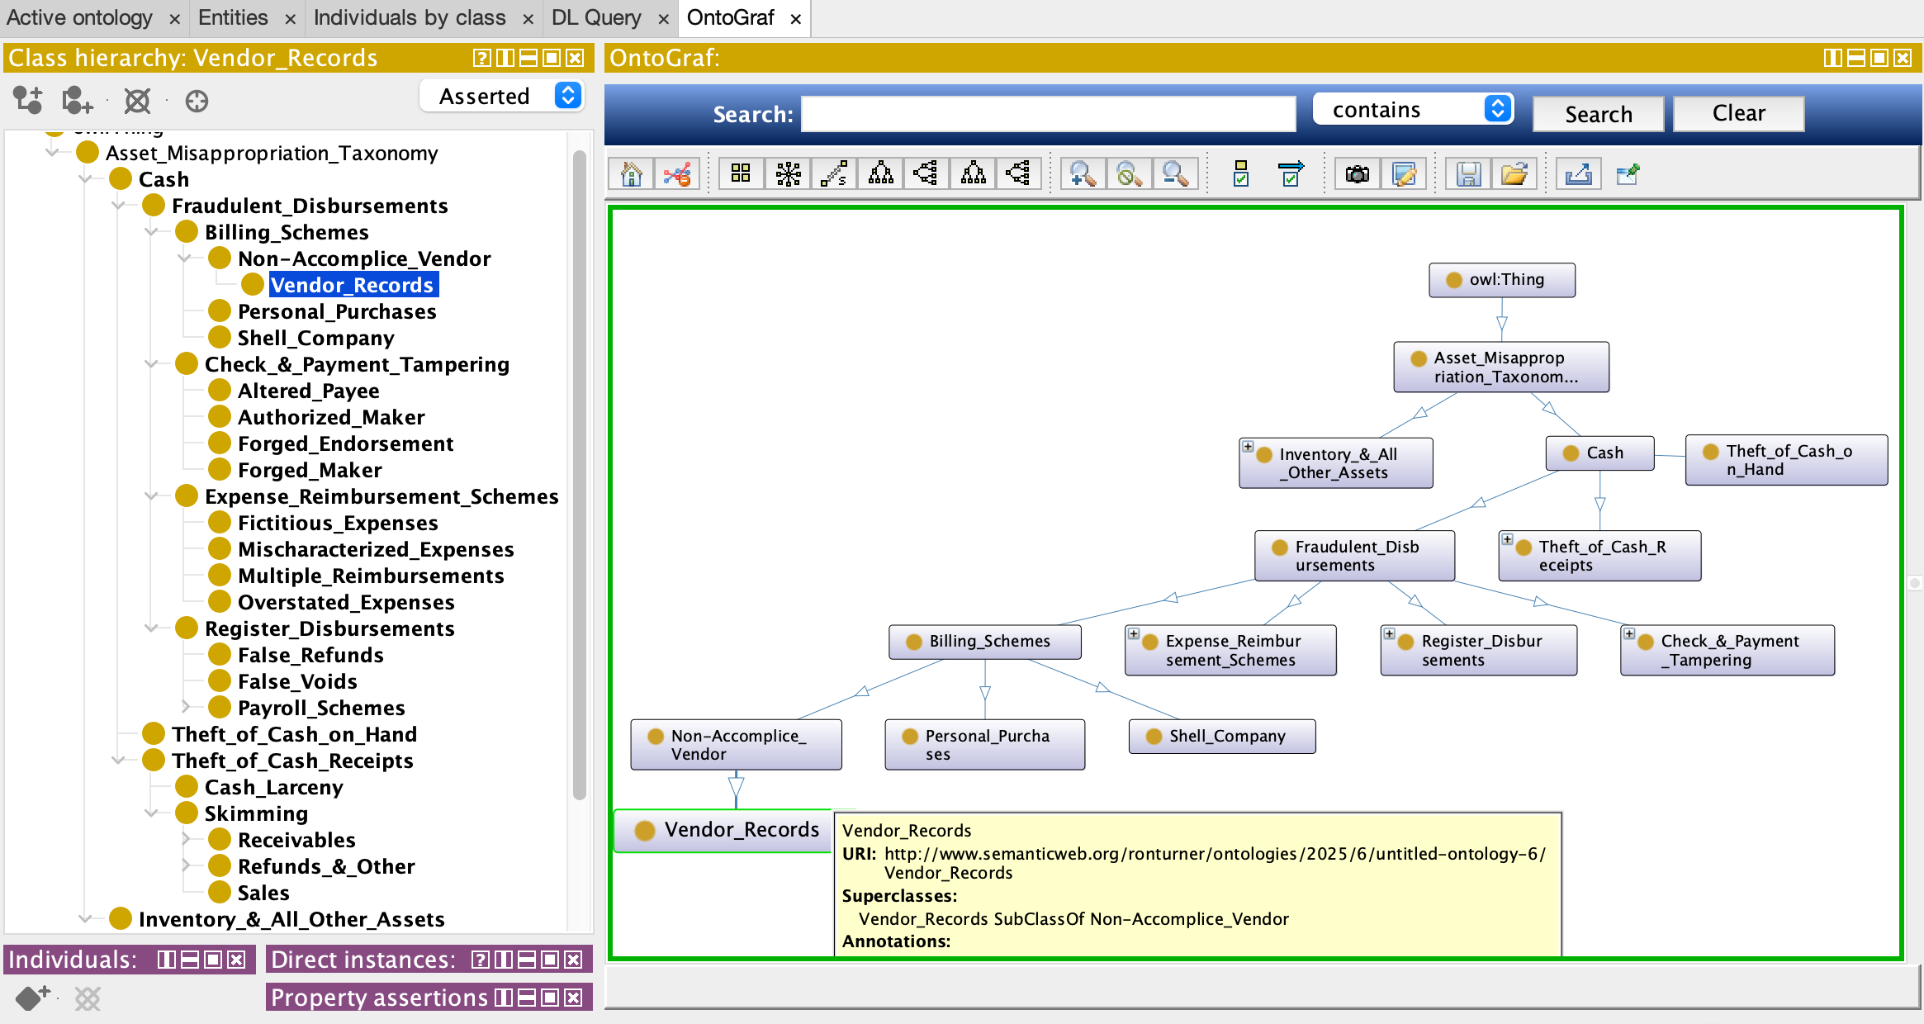
Notes:
Here’s Protégé visualization of part of the Asset Missappropriation taxonomy.
As we mentioned before, you don’t need Protégé to run NGRAM. But as a conscientious and curious data scientist it is almost imperative for you to have this tool to visually inspect the various OWL (.ttl) data.

Slide 10
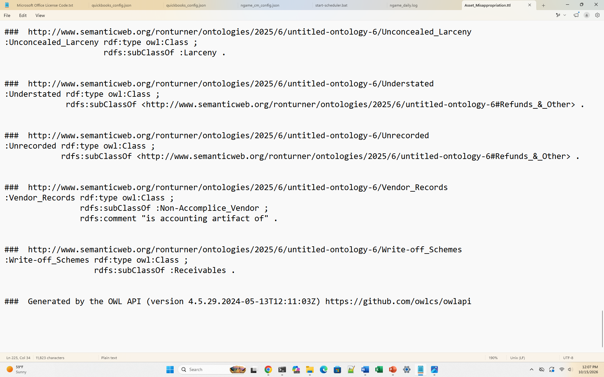
Notes:
Here is a portion of the AFCE Misappropriation taxonomy, rendered as Resource Definition Framework (RDF). RDF, which is a mainstream representation of OWL, in turn, is a W3C standard. The actual file type you’ll find in the GitHub repo is “.ttl” (commonly called “turtle”)

Slide 11
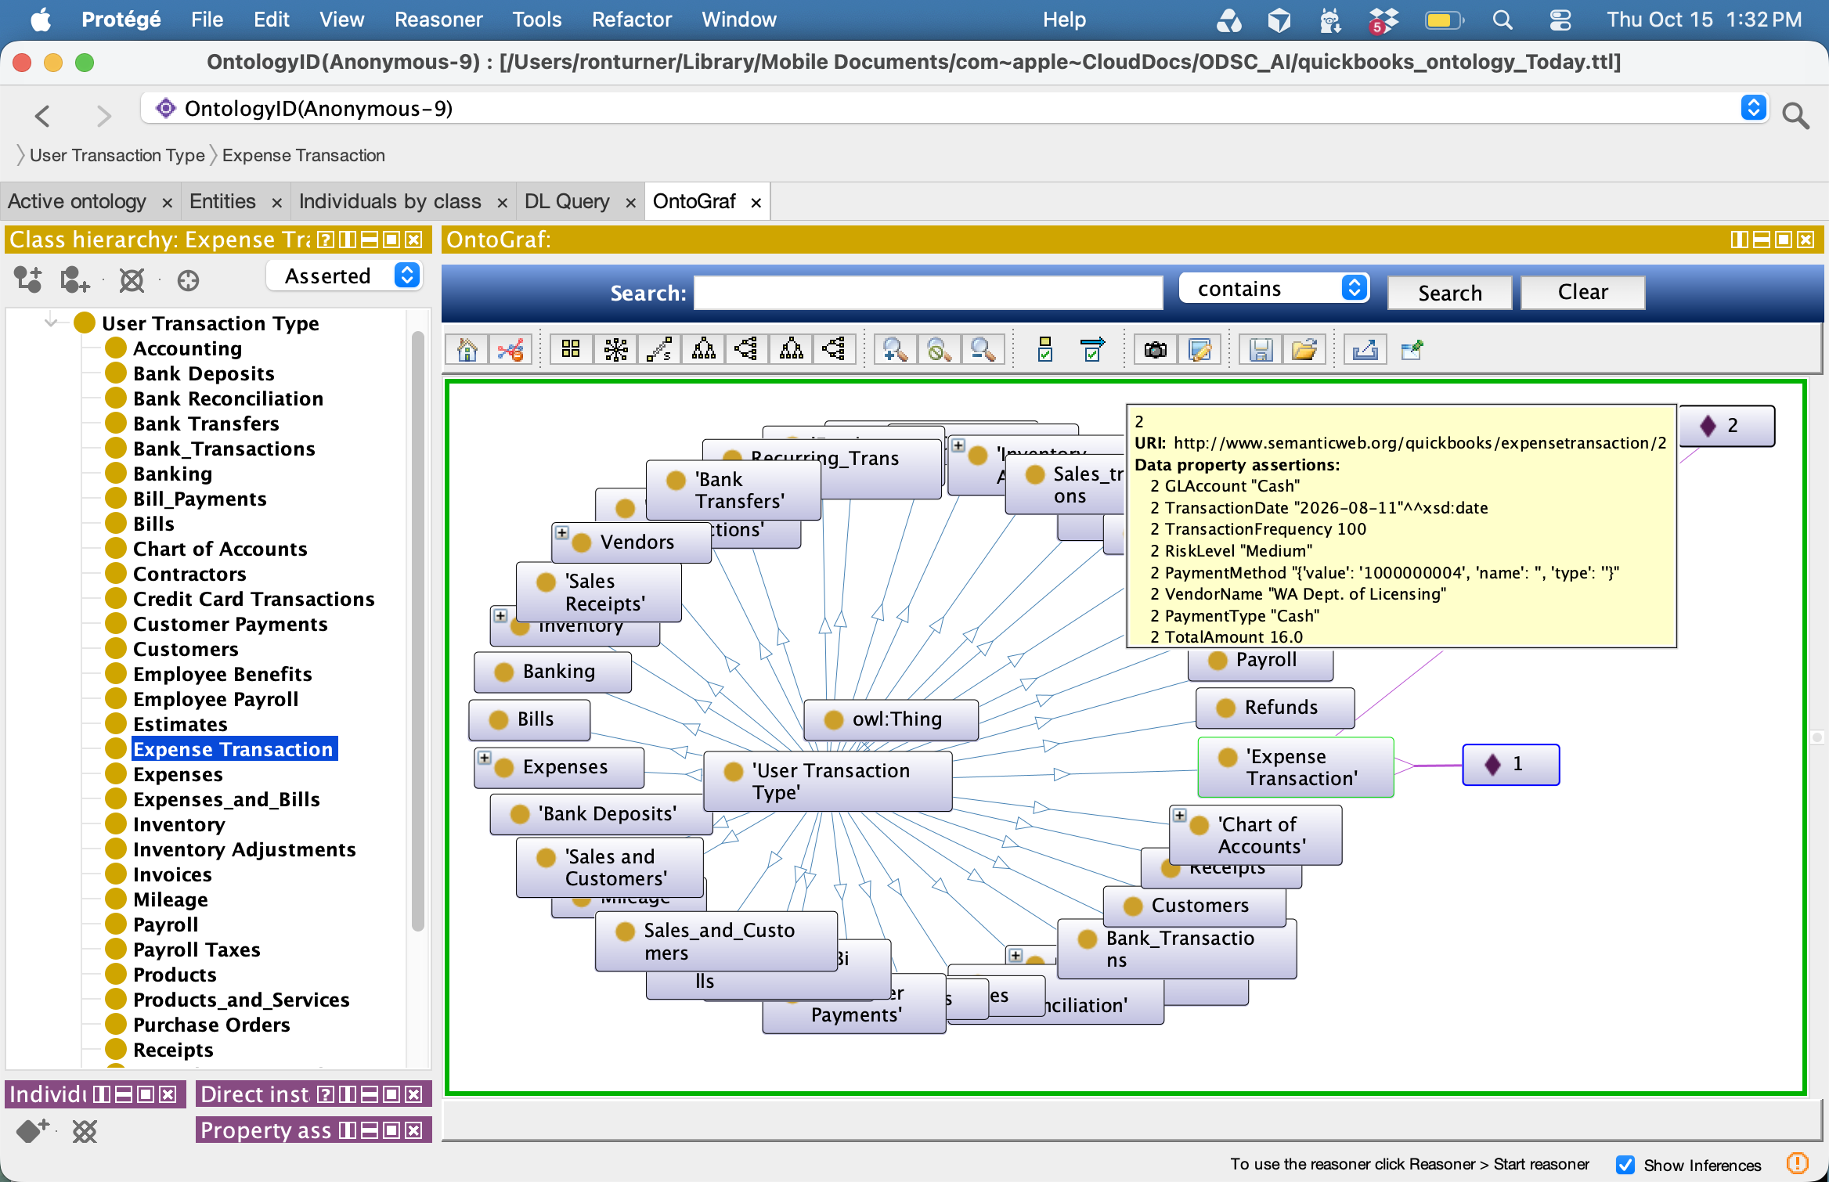
Notes:
When I paid to re-register my business with the State of Washington, I incurred an expense, which was recorded in my QuickBooks Online ledger. Note that the tooltip or explanation box from the Expense transaction contains all of the details associated with that payment.

Slide 12
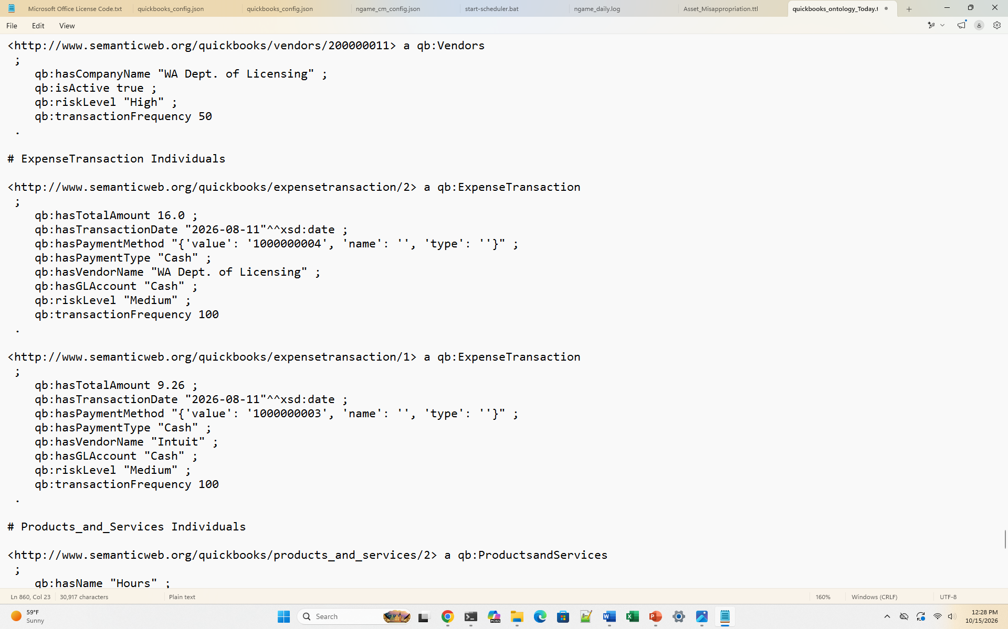
Notes:
Accordingly, here’s a portion of the actual .ttl file’s representation of the payment transaction.
As a mental placeholder, keep in mind that NGAME each day creates a .ttl file that records all of the day’s transactions for all of the transaction types in use that day. “Individuals” are the outermost nodes of the Protégé wheel.

Slide 13
Warning to FRP: auto-texted notification
NGAME picture — HIGH
NGAME took the scheduled picture for 2026-10-20.
Result: HIGH.
Open the dashboard on the NGAME computer to read last run, last result, scheduled successes, and next scheduled.
A quiet night does not send this message.
NGAME does not see every QuickBooks save. The Audit Log stays in QuickBooks.

Slide 14
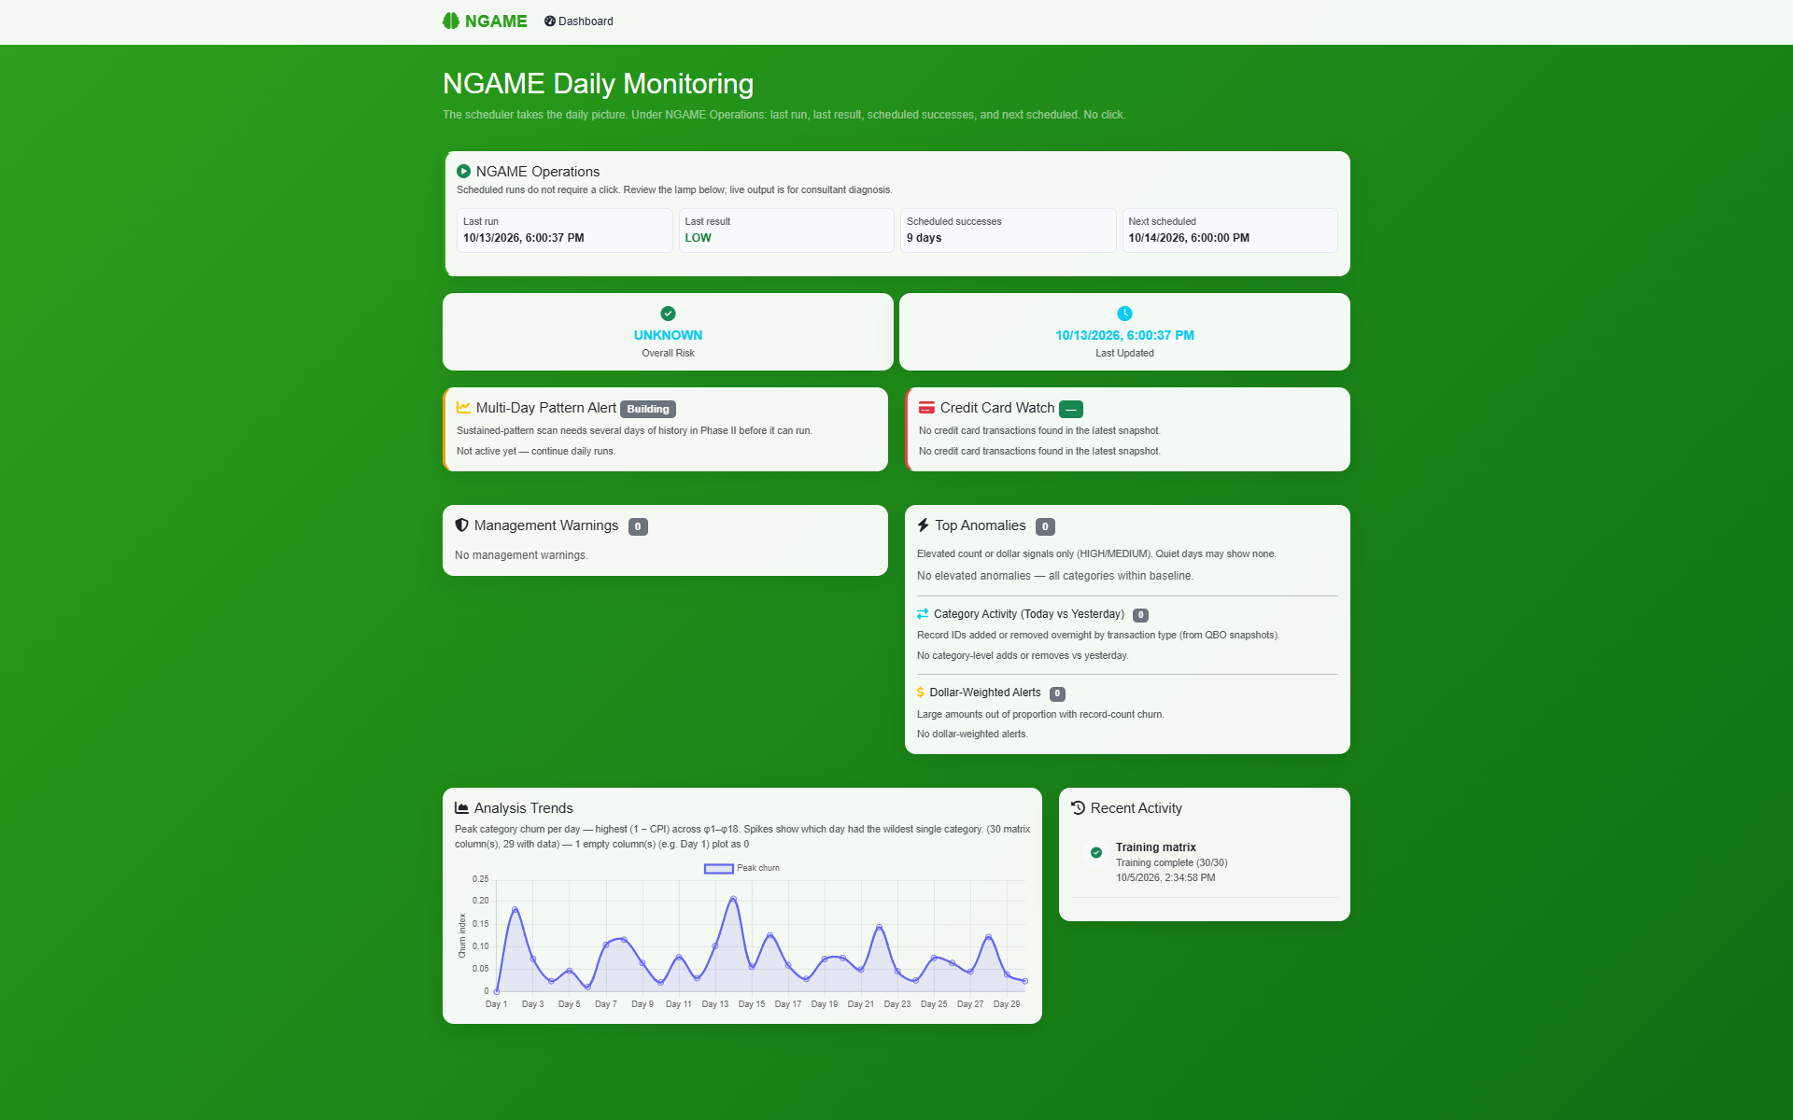

Slide 15
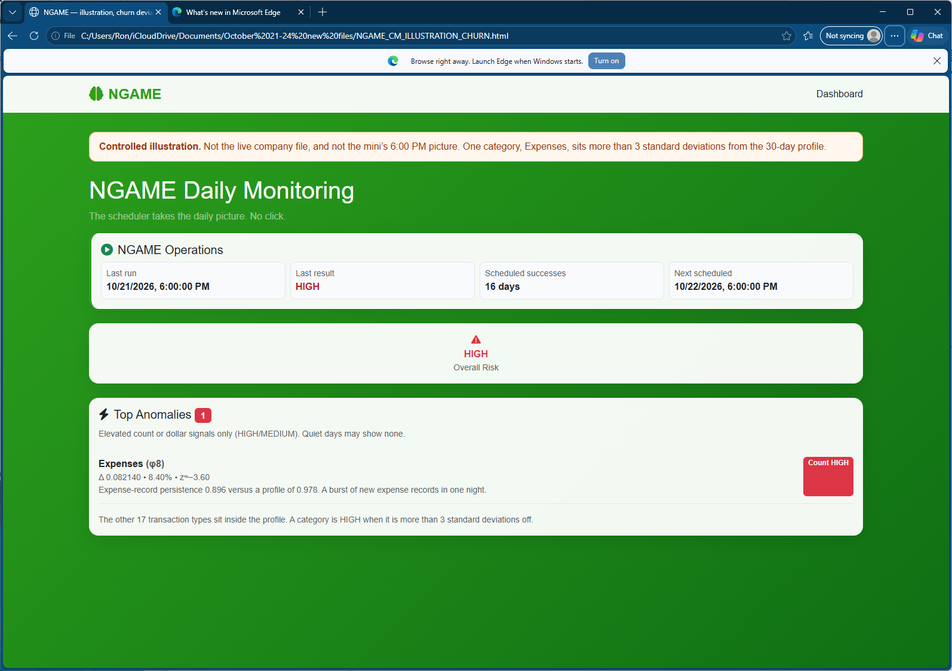
Churn Warning

Slide 16
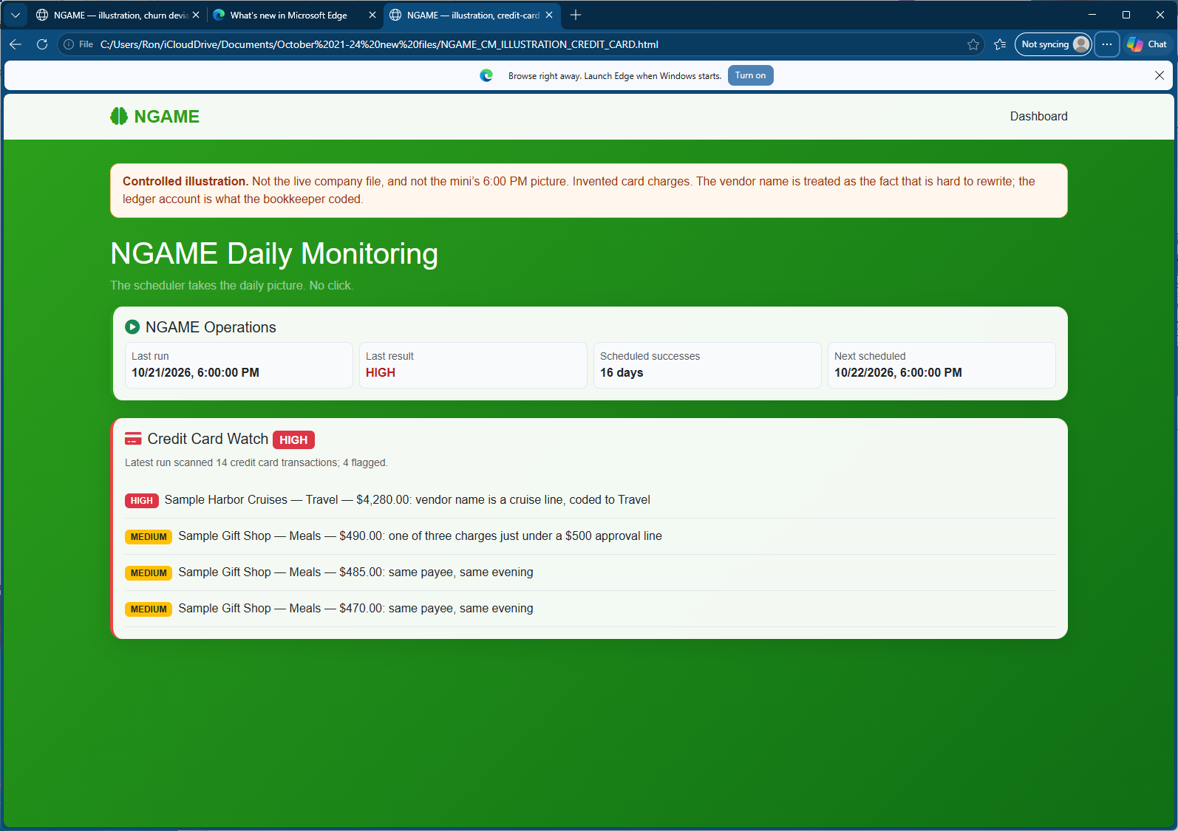
Credit card warning

Slide 17
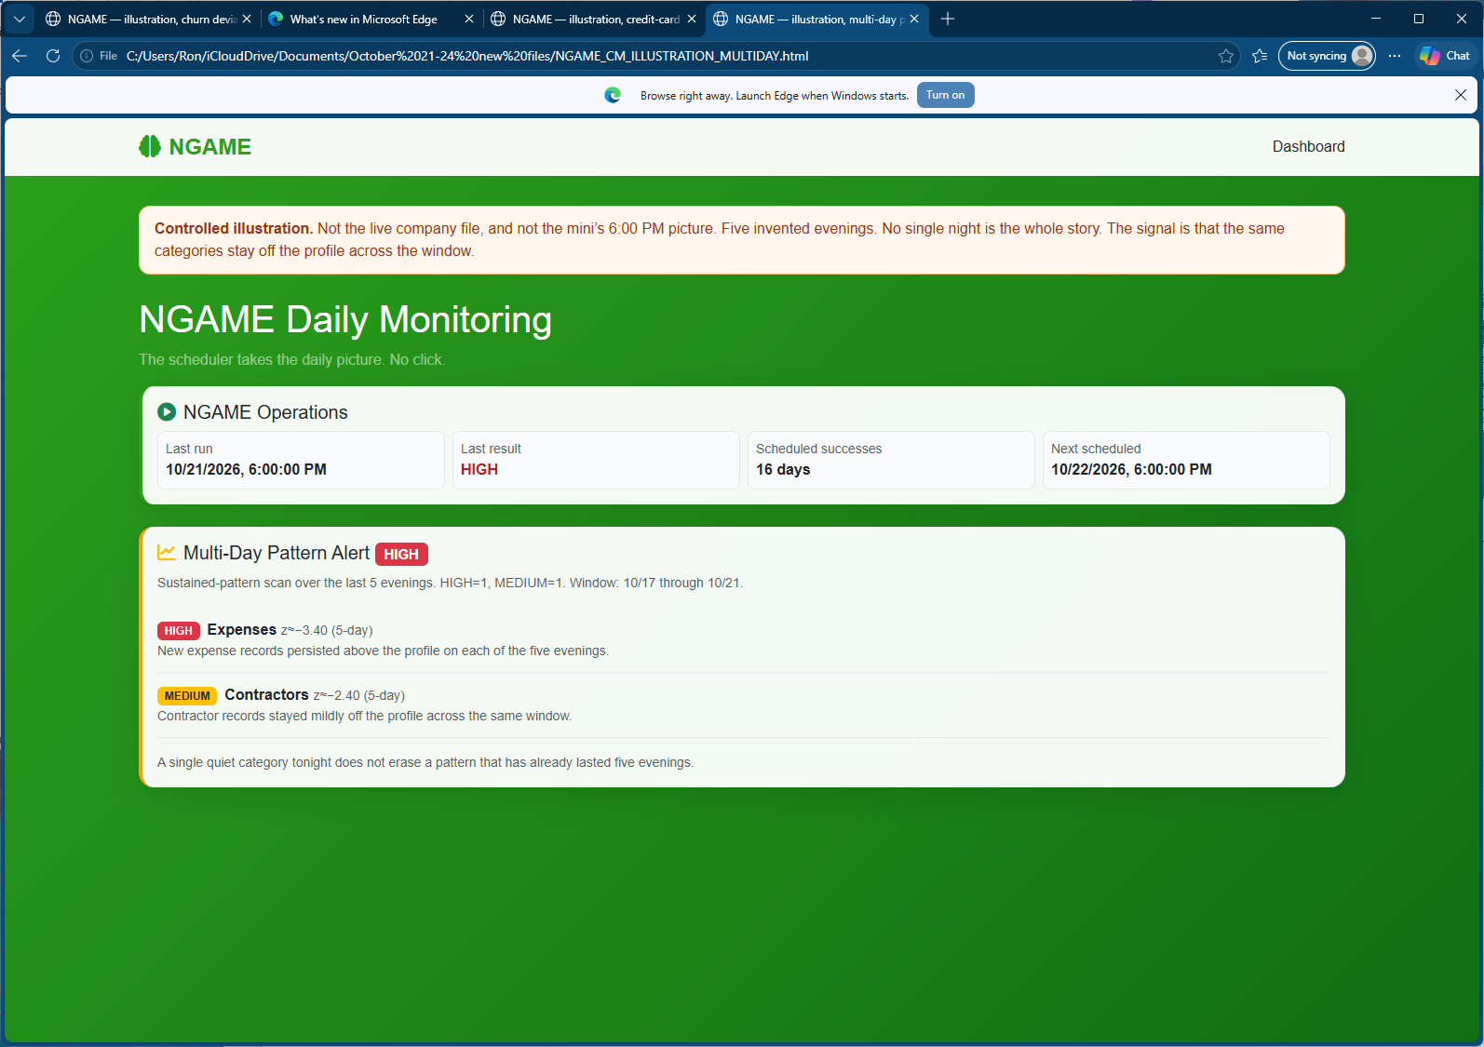
Multi-Day Alert

Slide 18
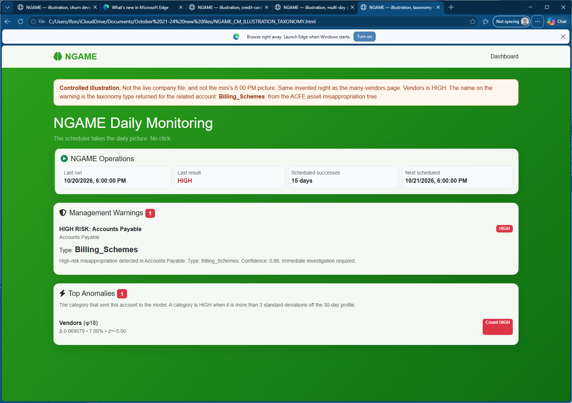
Vendors Alert

Slide 19
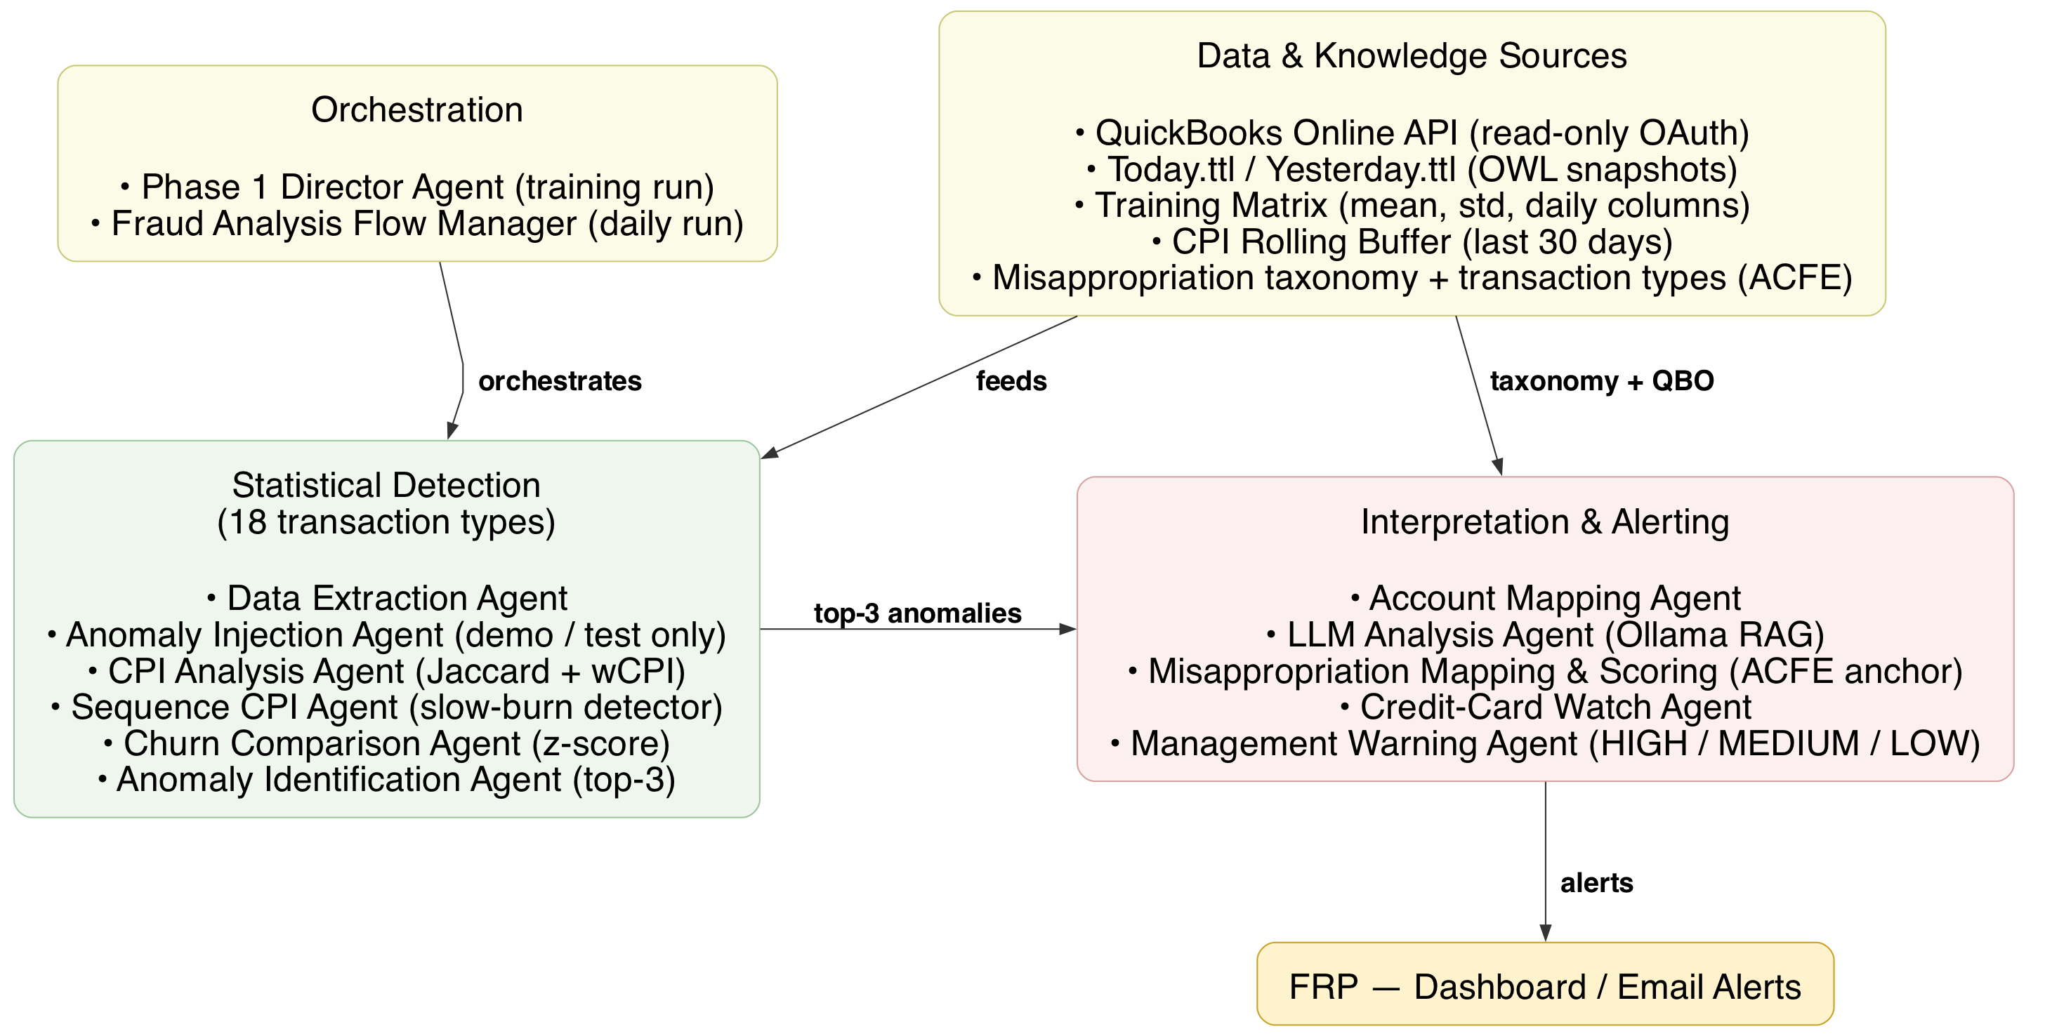
Agent-Driven Architecture

Slide 20
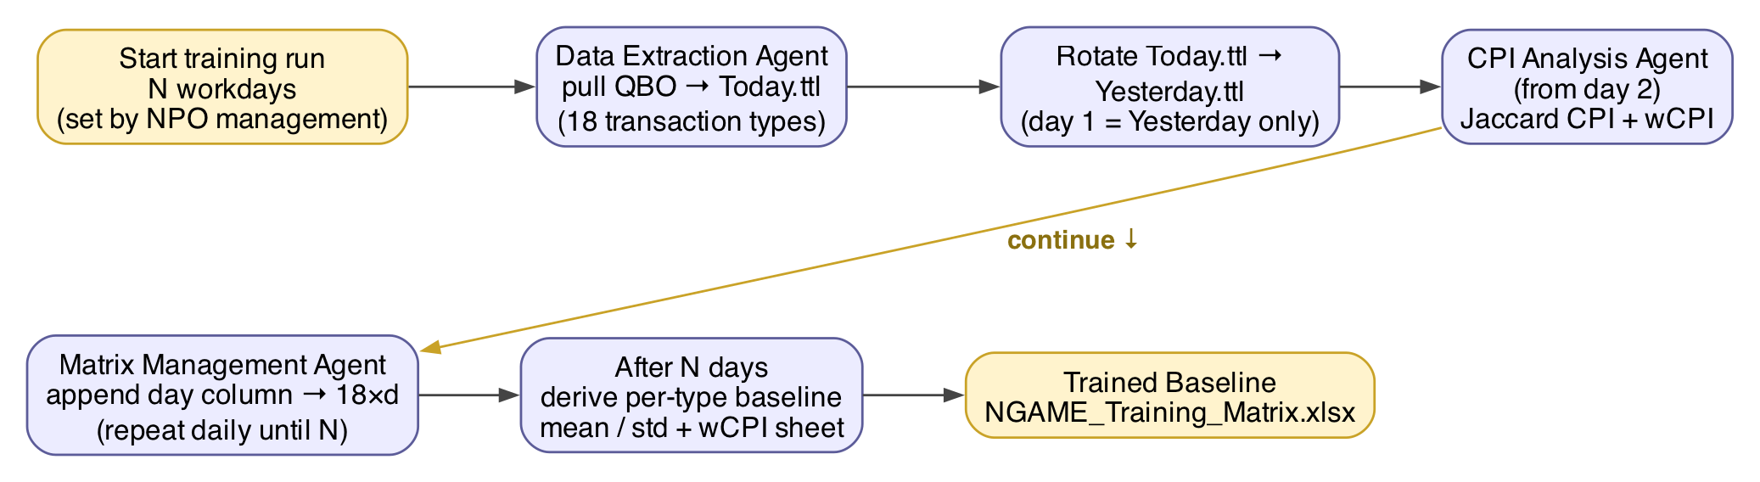
Training: 30-Day Baseline of Transaction Churn

Slide 21
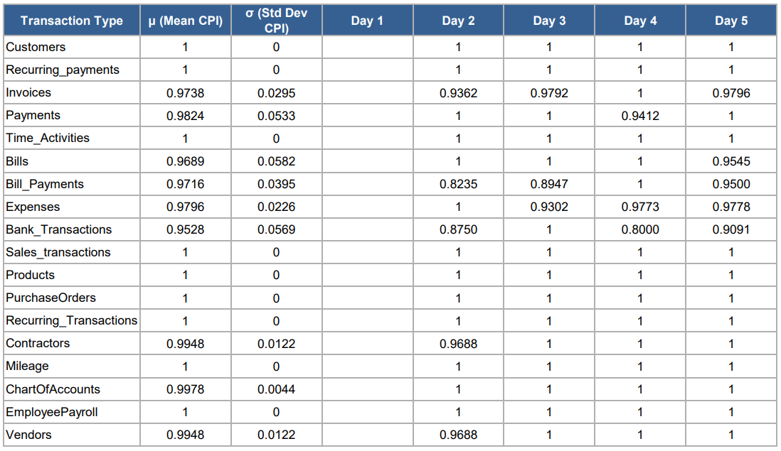
Training Matrix

Slide 22
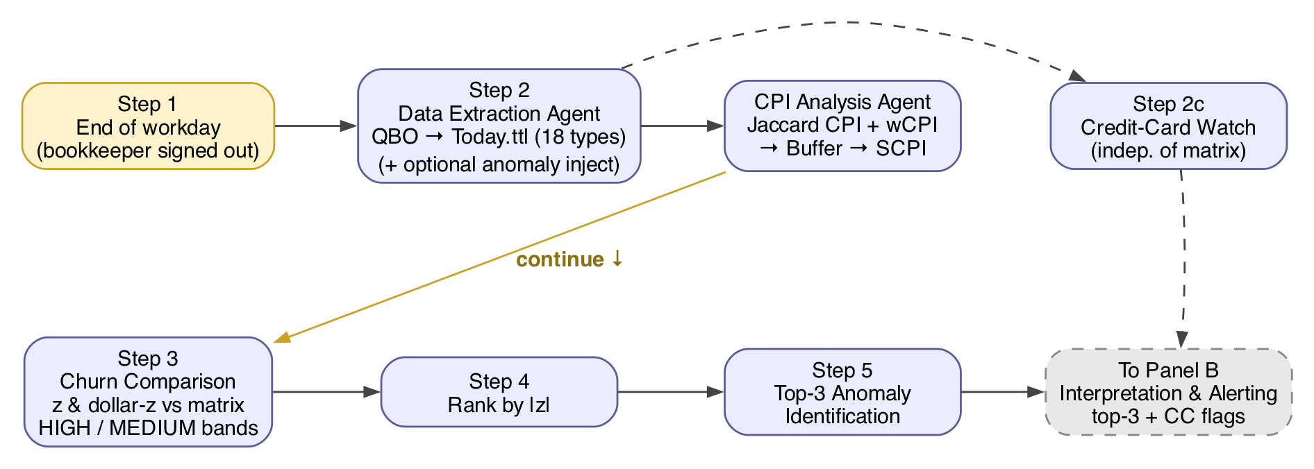
Anomaly Detection: Unusual Churn(s)

Slide 23
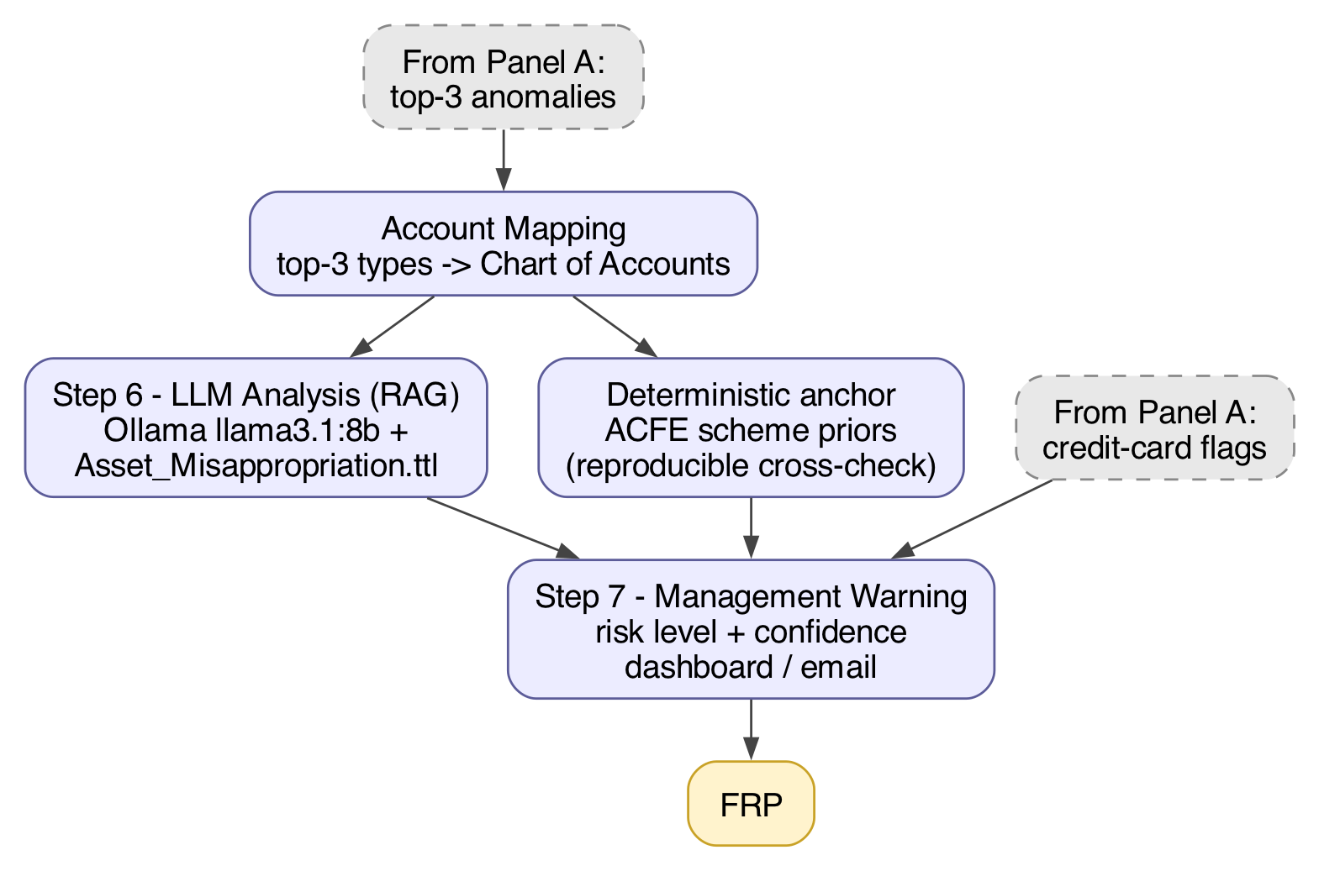
Fraud Detection: Possible Asset Misappropriation

Slide 24
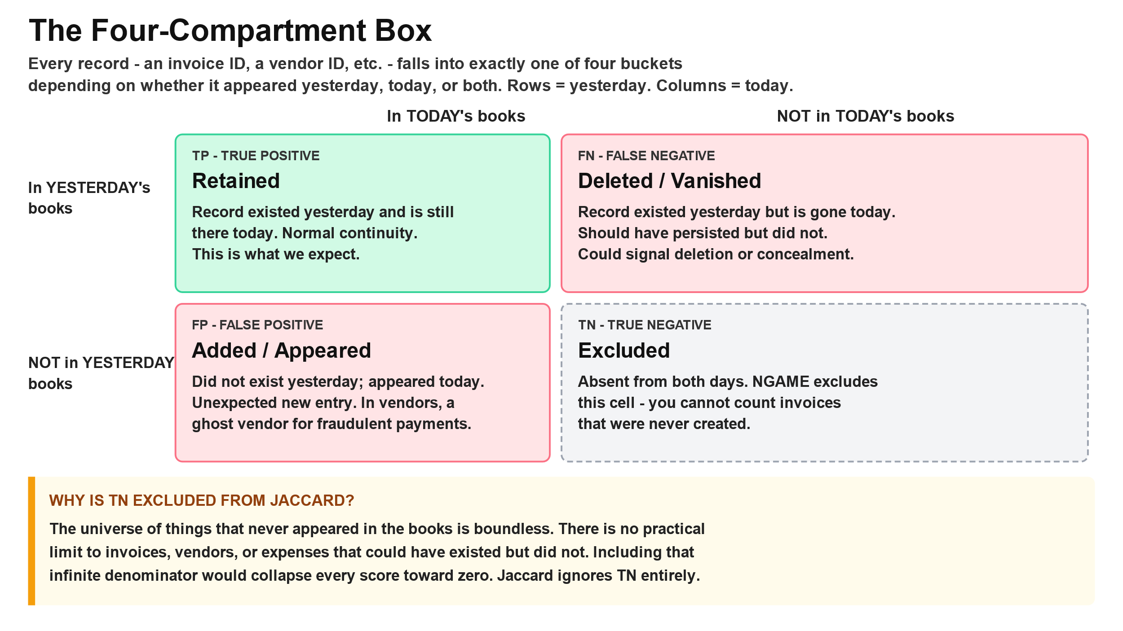

Slide 25
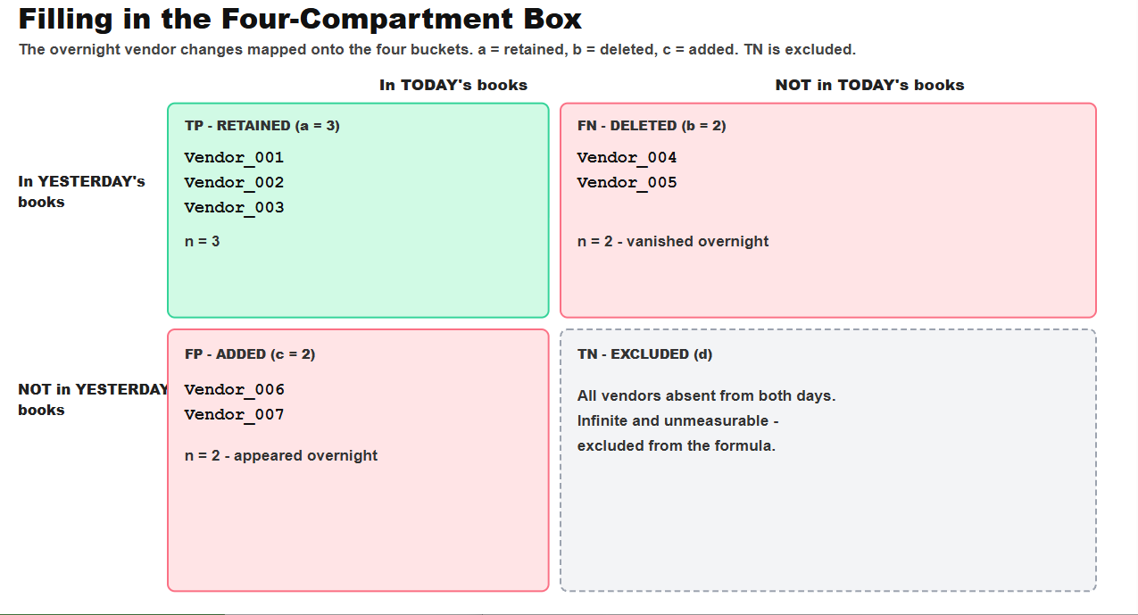
Filling the Jaccard boxes

Slide 26
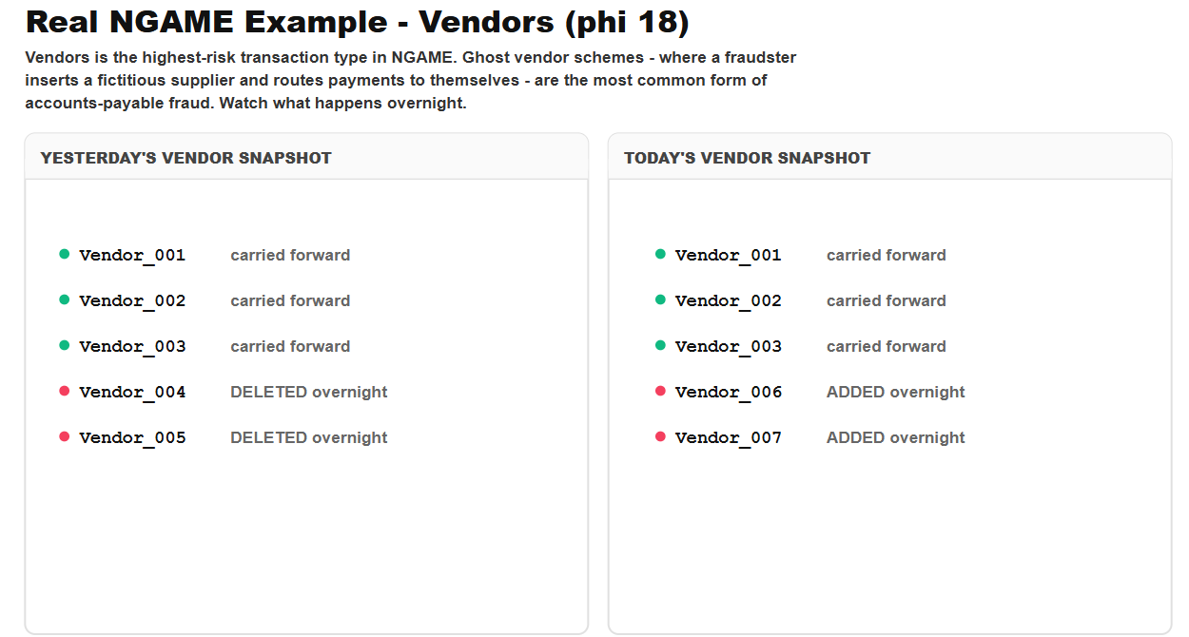
Ghost vendor activity

Slide 27
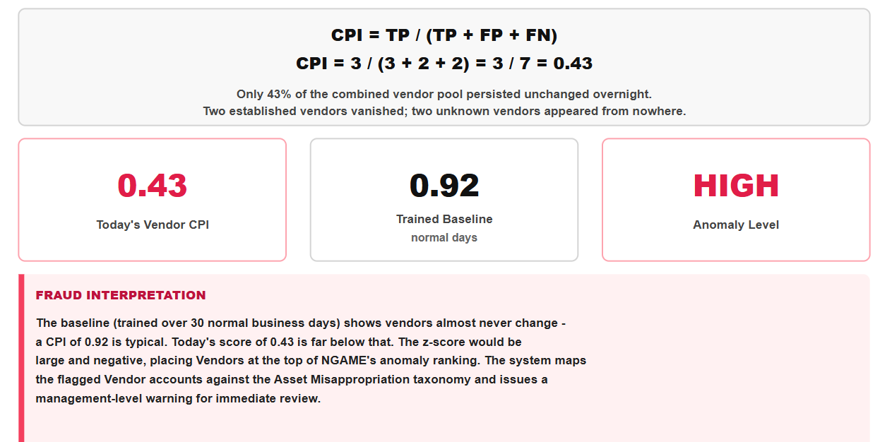
Calculating the Churn Persistence Index (CPI)

Slide 28
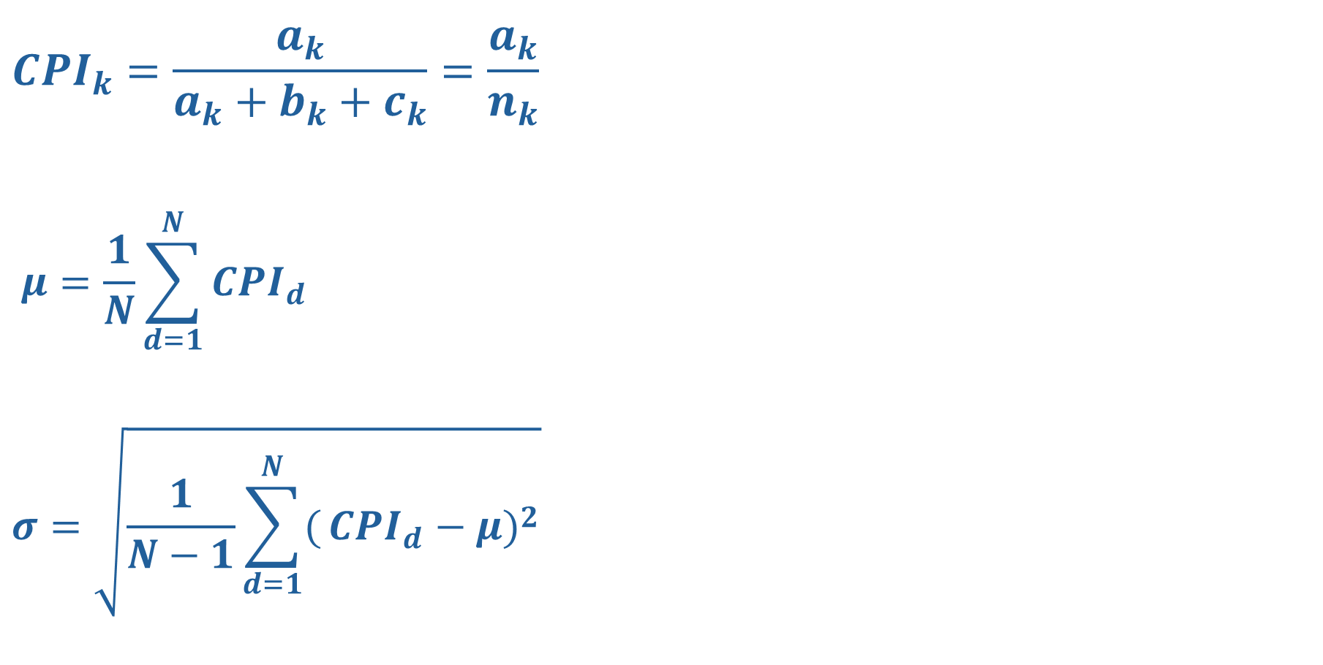
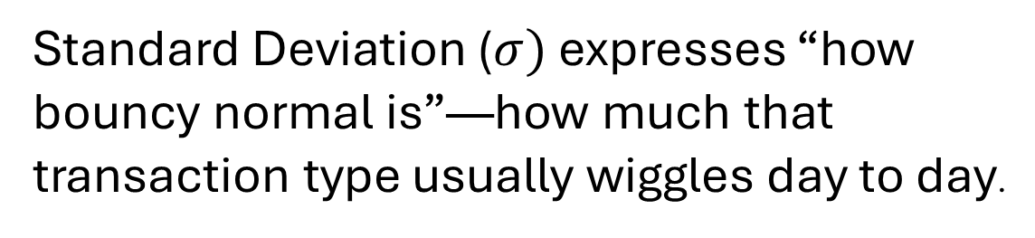
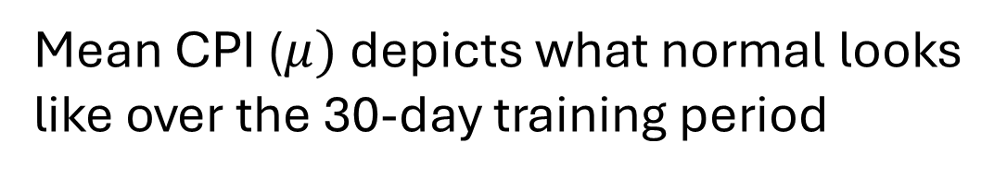
Formulas: CPI, Mu and Sigma
$${CPI}_{k}=\frac{a_{k}}{a_{k}+b_{k}+c_{k}}=\frac{a_{k}}{n_{k}}$$
$$μ=\frac{1}{N}\sum_{d=1}^{N}{{CPI}_{d}}$$
$$σ=\sqrt{\frac{1}{N−1}\sum_{d=1}^{N}{(}{CPI}_{d}−μ)^{2}}$$
Churn Persistence Index (CPI) is the Jaccard similarity of the two populations: Yesterday’s set of transactions vs. Today’s set of transactions
Mean CPI ($μ)$depicts what normal looks like over the 30-day training period
Standard Deviation ($σ)$ expresses “how bouncy normal is”—how much that transaction type usually wiggles day to day.

Slide 29

Z as warning level: “How serious is this churn . . really?”
$$z=\frac{\text{today}\text{’}\text{s} \text{CPI}−μ}{σ}$$
z is how many of this category’s own standard deviations tonight’s CPI sits from its own 30-day mean. A negative z means tonight’s CPI is below that mean, which is more churn. The warning is well-founded because the distance is measured in this organization’s own spread: |z| > 2 is MEDIUM, and |z| > 3 is HIGH.
Notes:
Vendors stayed steady across those 30 days. Bills did not. Bills’ sigma, 0.0582, is about five times Vendors’ sigma, 0.0122, so the Bills score already swung widely from day to day while the Vendors score stayed close to its own average.The same size dip tonight is ordinary for Bills and unusual for Vendors. Vendors has to move only a little to look far off its history. Bills has to move much farther before the same warning is warranted.s

Slide 30
Next?
Clone NGAME-CM (Autonomous Continuous Monitoring Engine): http://github.org/ronaldcturner/ngame-cm
Browse through manuals for the IT and the FRP.
Help protect your favorite small (non-profit, charity, congregation, community…) organization by using the 36-Page NGAME-CM — Installation Guide to deploy NGAME-CM.
Cannibalize the codebase imaginatively to apply Churn for effective, small-footprint anomaly detection in other time-series applications.
Write to me at RonTurnersBox@gmail.com
Come to Audithentic.ai to see an exec-level description of NGAME

